Slide 1

Predicting Customer Booking Behaviour Model

Slide 2
Objective
Predict which customers will complete a flight booking, enabling proactive offers and engagement.
Approach
Explored and cleaned dataset
Encoded categorical variables
Applied SMOTE to fix class imbalance
Trained RandomForestClassifier with class weights
Validated using cross-validation
Visualized feature importance
Key Results
Accuracy: ~85%
CV Score: ~81%
Class 1 Recall: ~75%
Top Features: booking_origin, flight_duration, length_of_stay, sales_channel, route

Slide 3
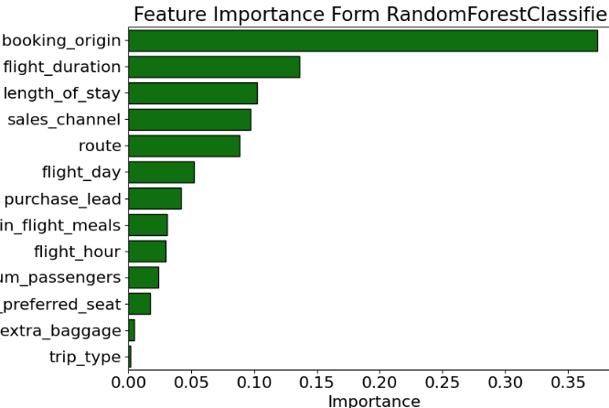
Insight Early leads and short trip types are strong booking indicators.

